Slide 1

SPACE TRADER
TOLGA ÇOBANOĞLU EGEMEN TOKGÖZ

Slide 2
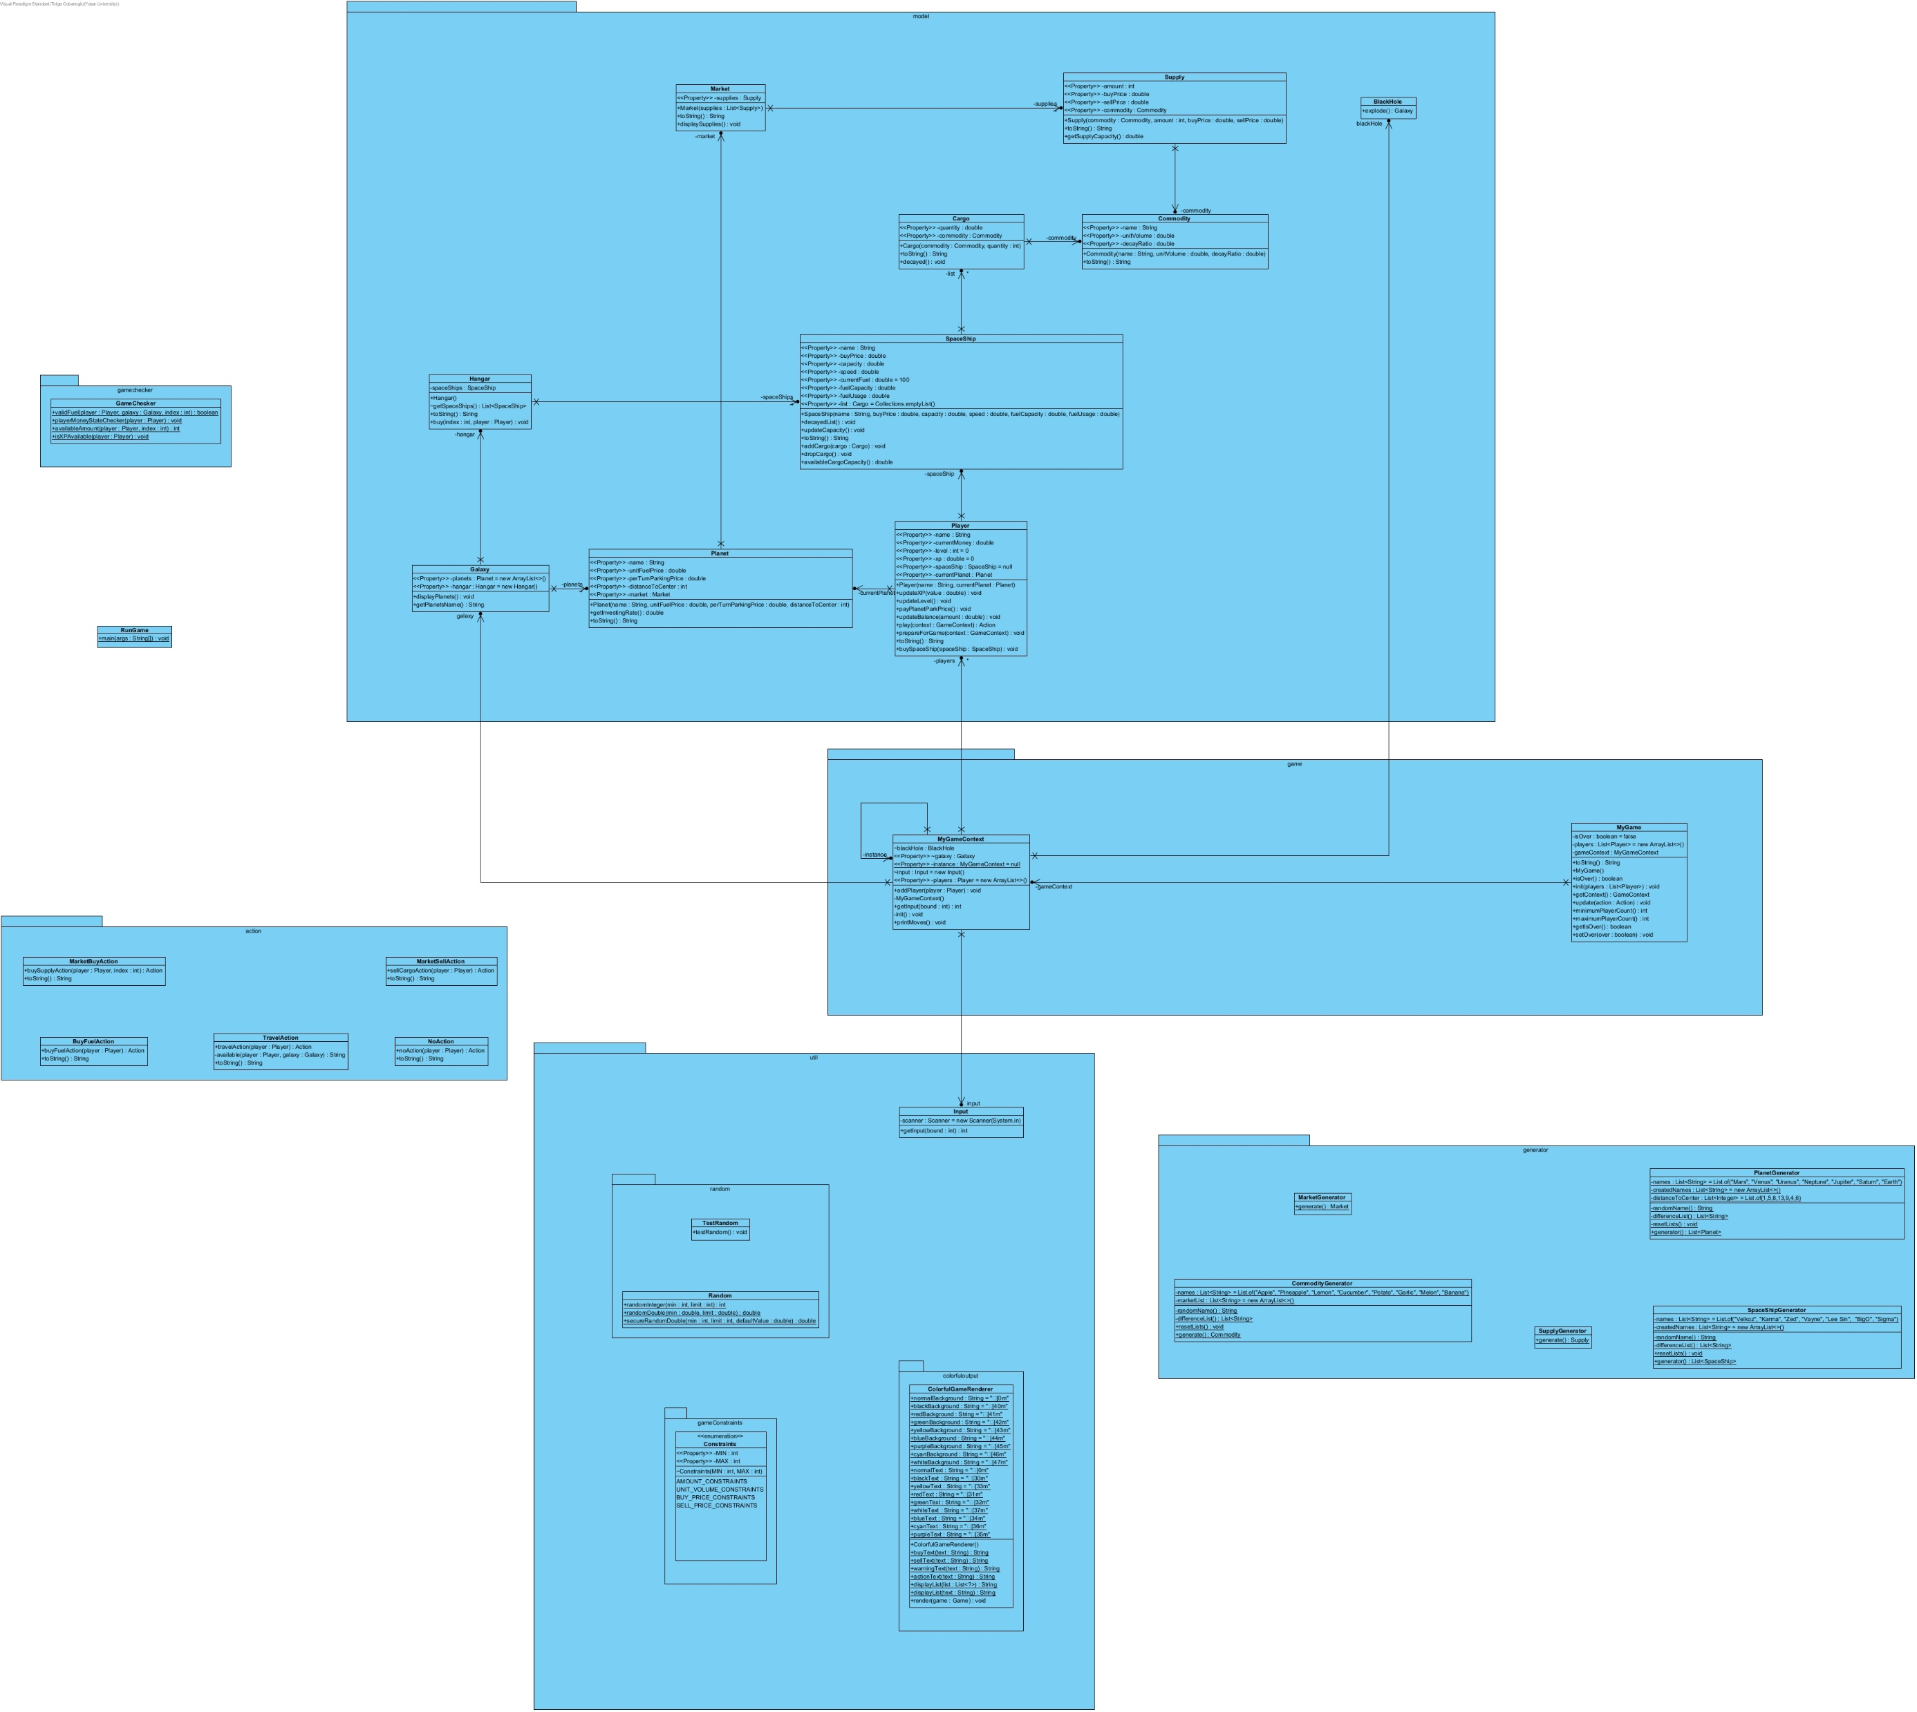
BASE PACKAGES
Action
Game
GameChecker
Generator
Model
Util

Slide 3
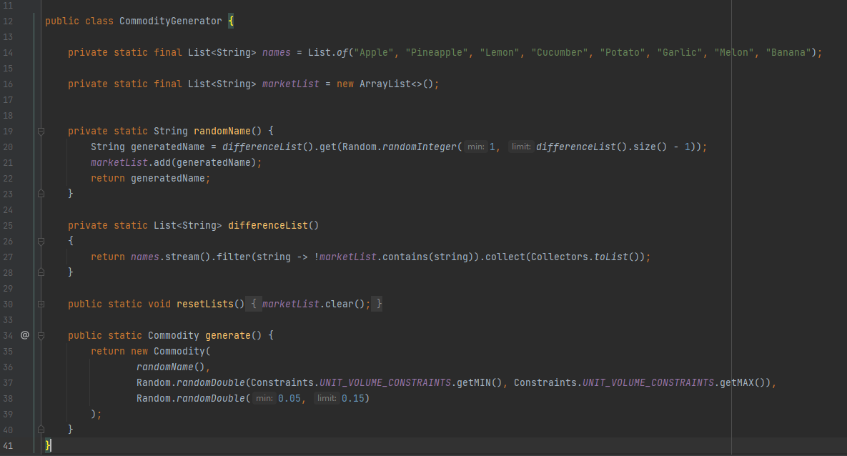
COMMODITY GENERATOR

Slide 4
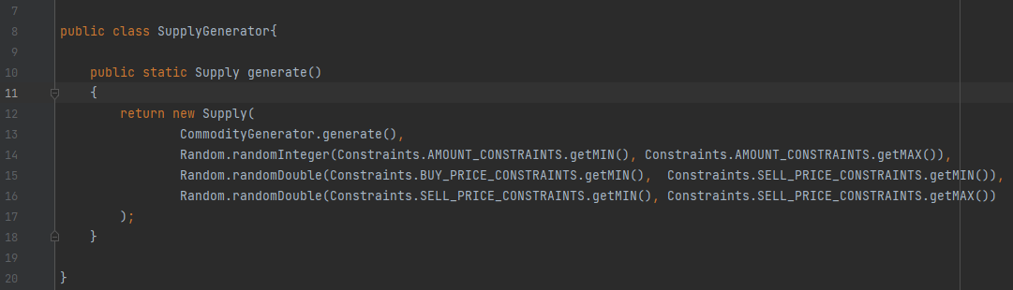
SUPPLY GENERATOR

Slide 5
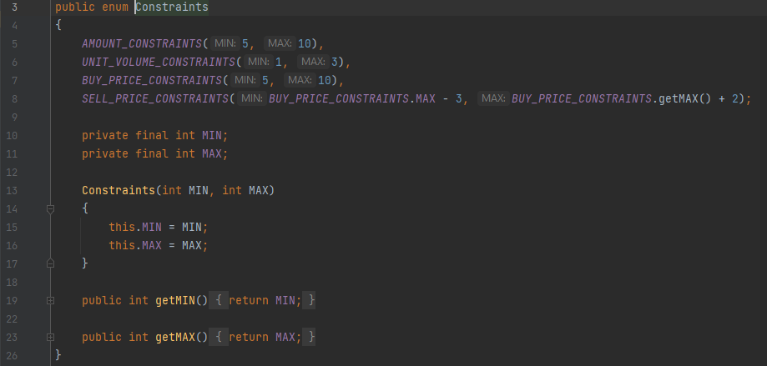
GAME CONTRAINTS
Constraints for some game objects

Slide 6
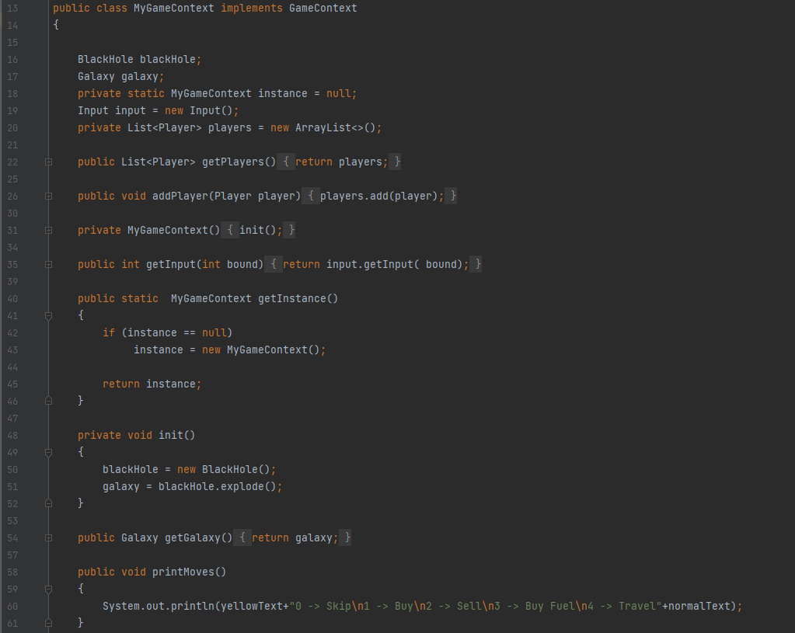
GAME CONTEXT
Using singleton pattern in MyGameContext class

Slide 7
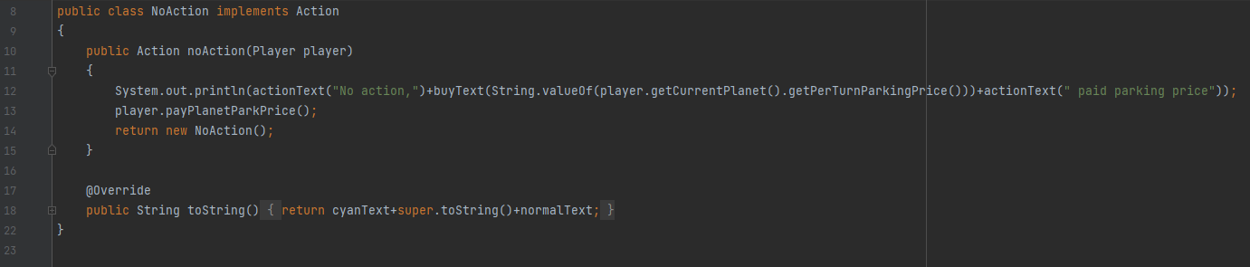
NO ACTION

Slide 8
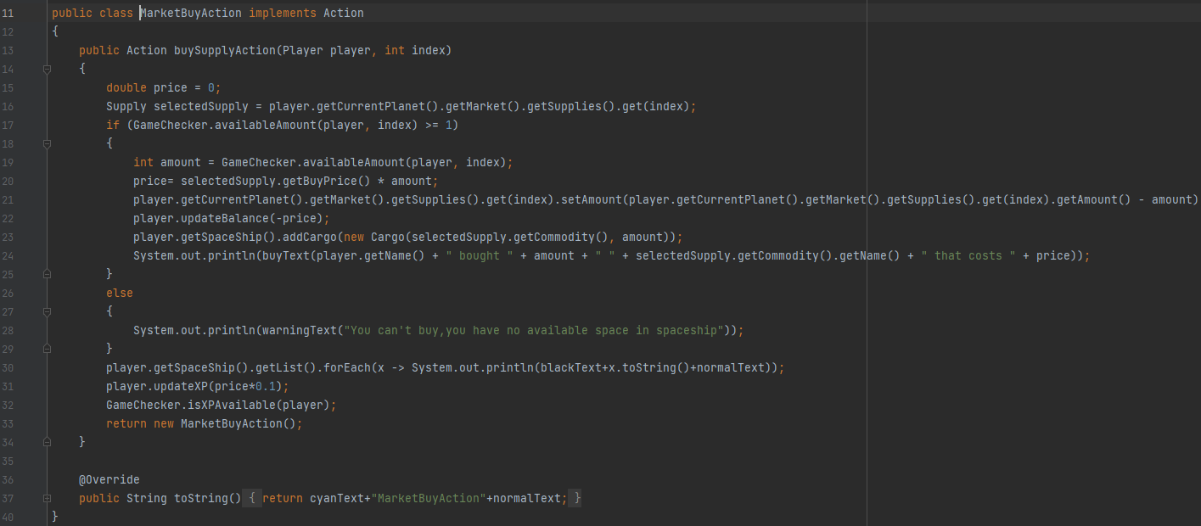
MARKET BUY ACTION

Slide 9
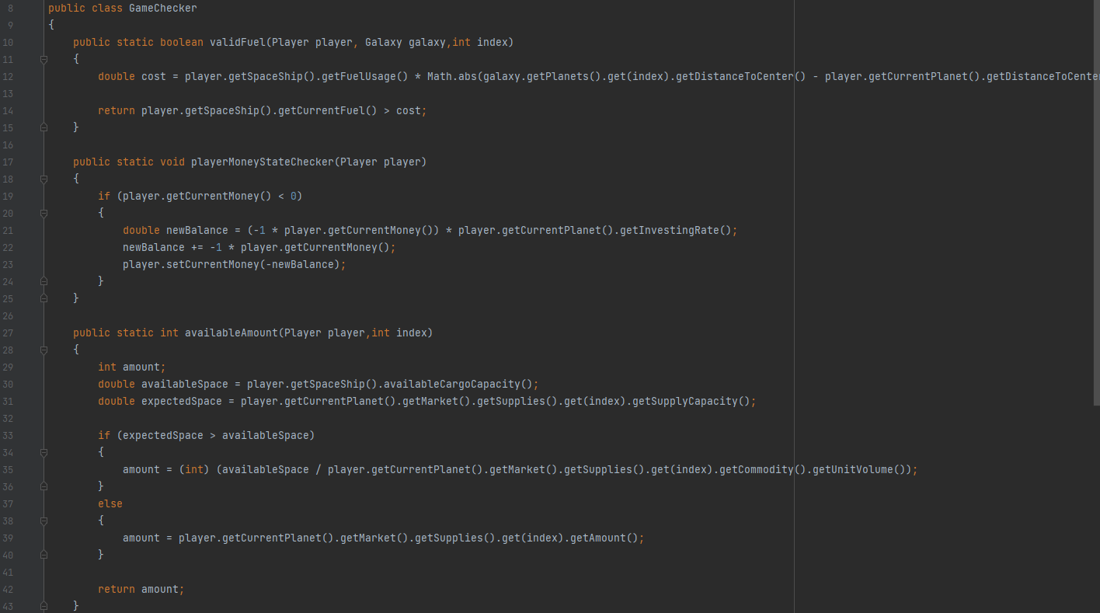
GAME STATE CHECKER

Slide 10
OPTIONAL BONUS ITEMS
COLORFUL OUTPUT FOR GAME RENDERER ColorfulGameRenderer.java
PLAYER LEVEL SYSTEM FOR LEVEL AND GAME FEATURE

Slide 11
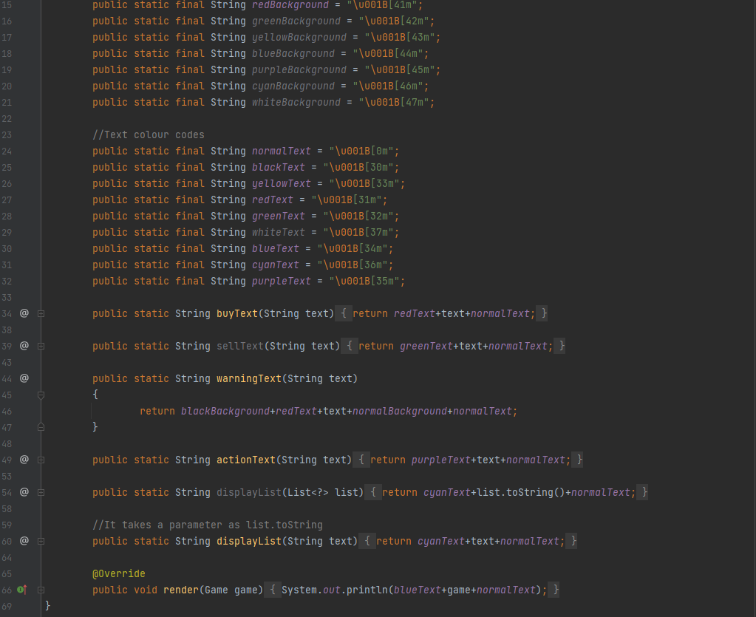
COLORFUL OUTPUT FOR GAME RENDERER
Aim to design class like a library who wants to take output which colours want use they can choose any color and background colour style the output.

Slide 12
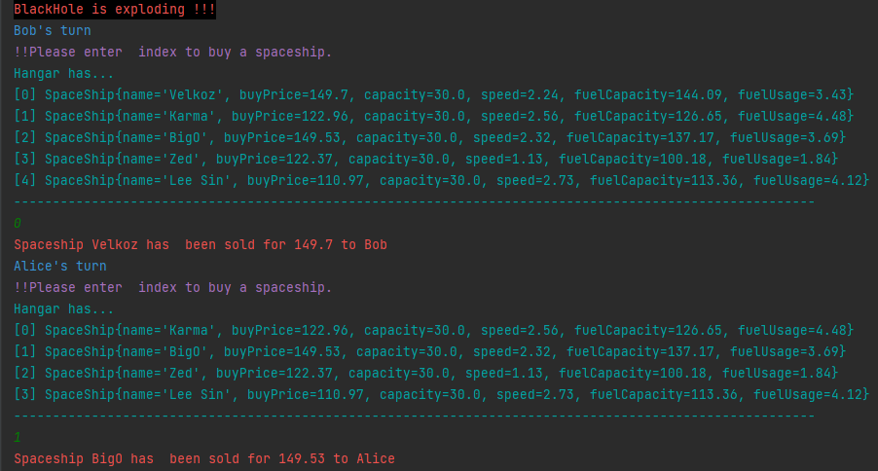
EXAMPLE FOR COLORFUL OUTPUT ON CONSOLE
When game is start,asked to player which spaceship youu want ?

Slide 13
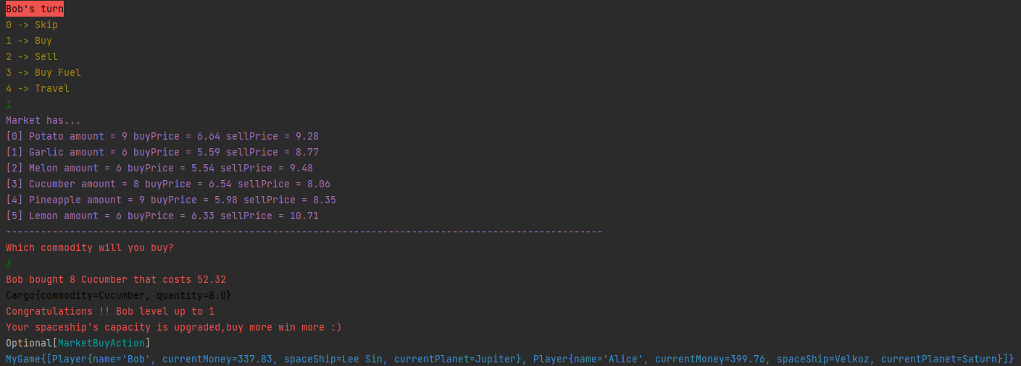
EXAMPLE FOR COLORFUL OUTPUT ON CONSOLE AND LEVEL SYSTEM
Game asked to player which action will you do in your turn and player choose index of the action and continue,after the buy action. After the buy action player gains and XP if it enough the player level up.XP bar designed with proportional to the level.The main advantage of the level system,the player's cargo capacity increases in direct proportion to her/his level.

Slide 14
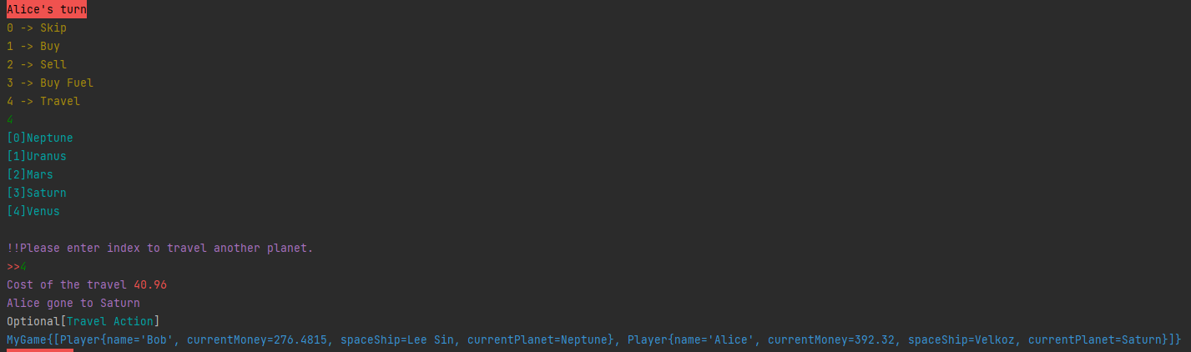
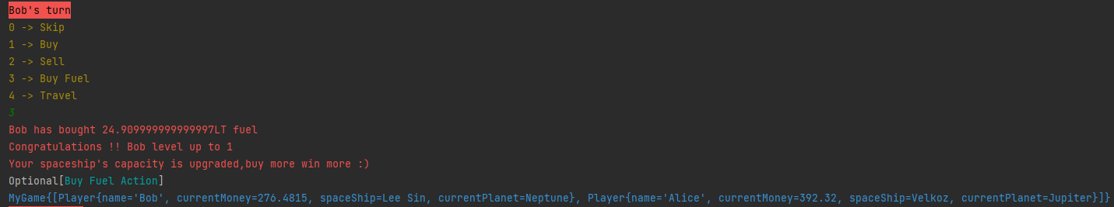
EXAMPLE FOR COLORFUL OUTPUT ON CONSOLE

Slide 15
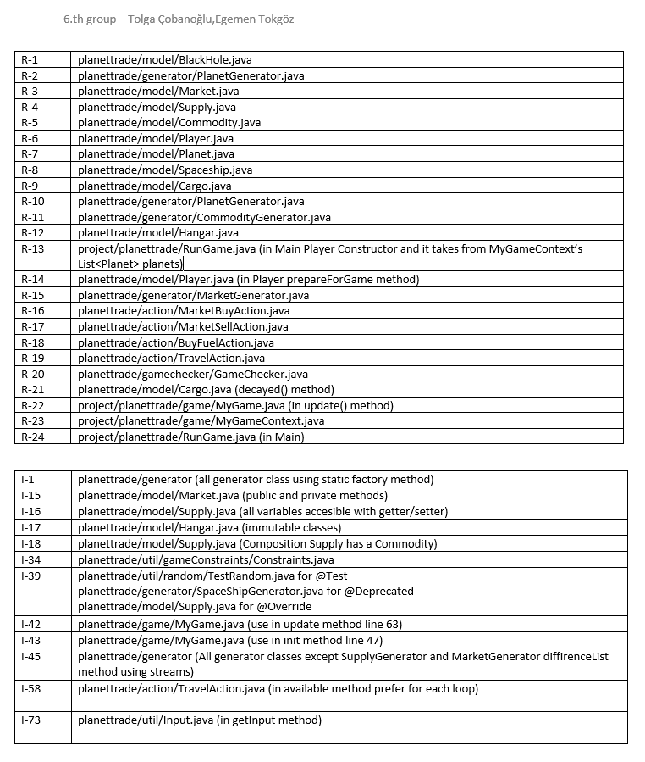
REQUIREMENTS AND ITEMS LIST

